Slide 1
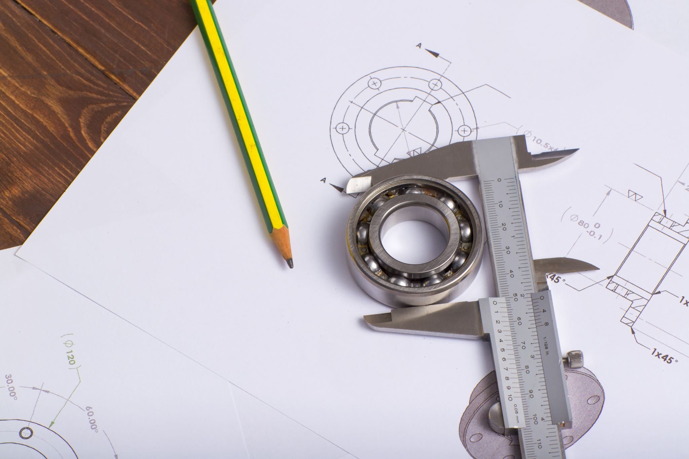
Damage Detection on Bearings
Condition Monitoring Project
By Nishilkumar Balar
Matriculation No. – 1638936
Email id: nishilkumar.balar@student.uni-siegen.de
Data Archive: WS2223_16
Password: WS2223_164923

Slide 2
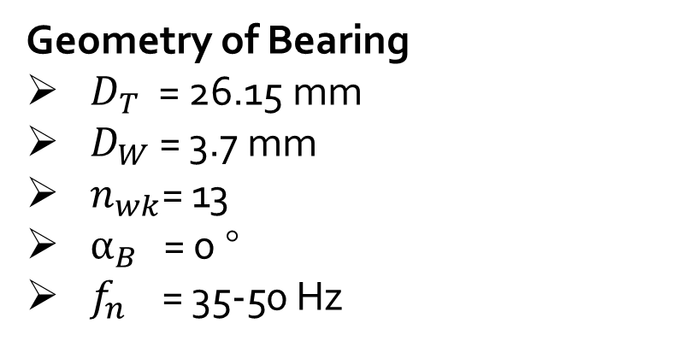
Experimental Setup
Accelerometer sensor (vibration sensor)
Sensor type: PCB 353B15
Bearing (SKF - 61804)
Coupler type: Kistler 5134A
Measurement device: dSPACE MicroLabBox (16 Bit A/D Converter)
Sampling Frequency: 40kHz
FOCUS!
Geometry of Bearing
$D_{T}$ = 26.15 mm
$D_{W}$= 3.7 mm
$n_{wk}$= 13
$α_{B}$ = 0 °
$f_{n}$ = 35-50 Hz

Slide 3
Objective
Data Archive: WS2223_16 (data of signal for 3 different bearings)
The project's goal is to analyze three provided signals that are composed of information from a bearing. We must determine which signal is the damaged signal in order to identify the data that the signals convey about the damaged bearing.
Proposed steps
File Name
file_004_23192223 – Signal 1
file_009_23192223 – Signal 2
file_023_23192223 – Signal 3
Time Domain Signal Analysis
Frequency Domain Signal Analysis
Envelope Spectra Analysis
Time-Frequency Domain Signal Analysis
Spectral Kurtogram
Band-Pass Filter

Slide 4
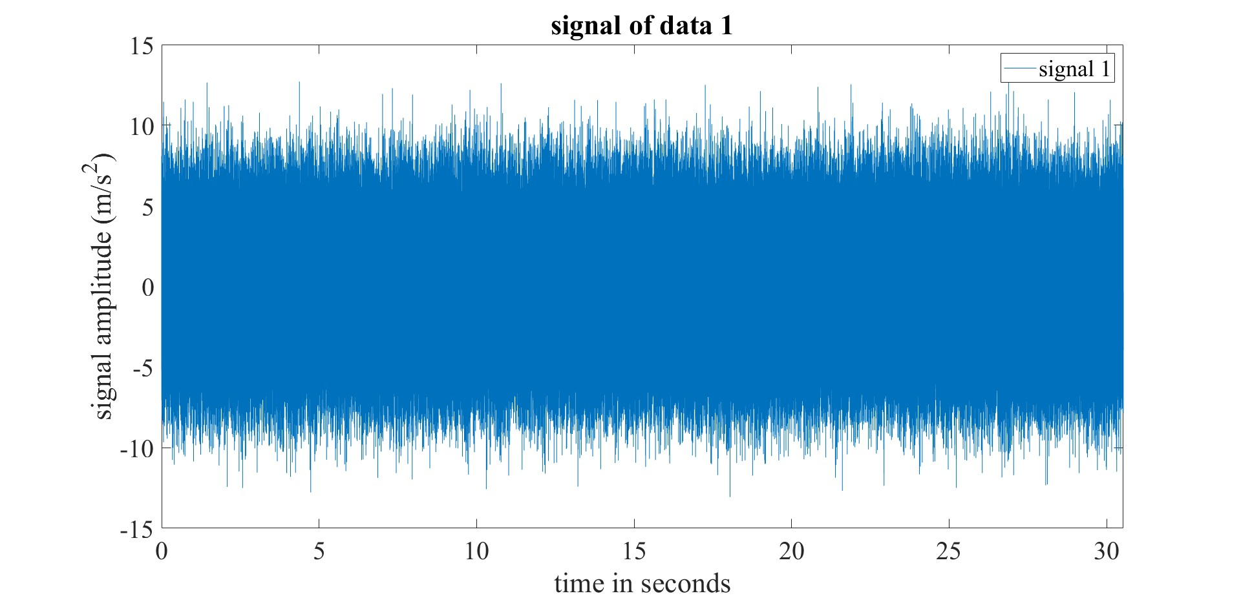
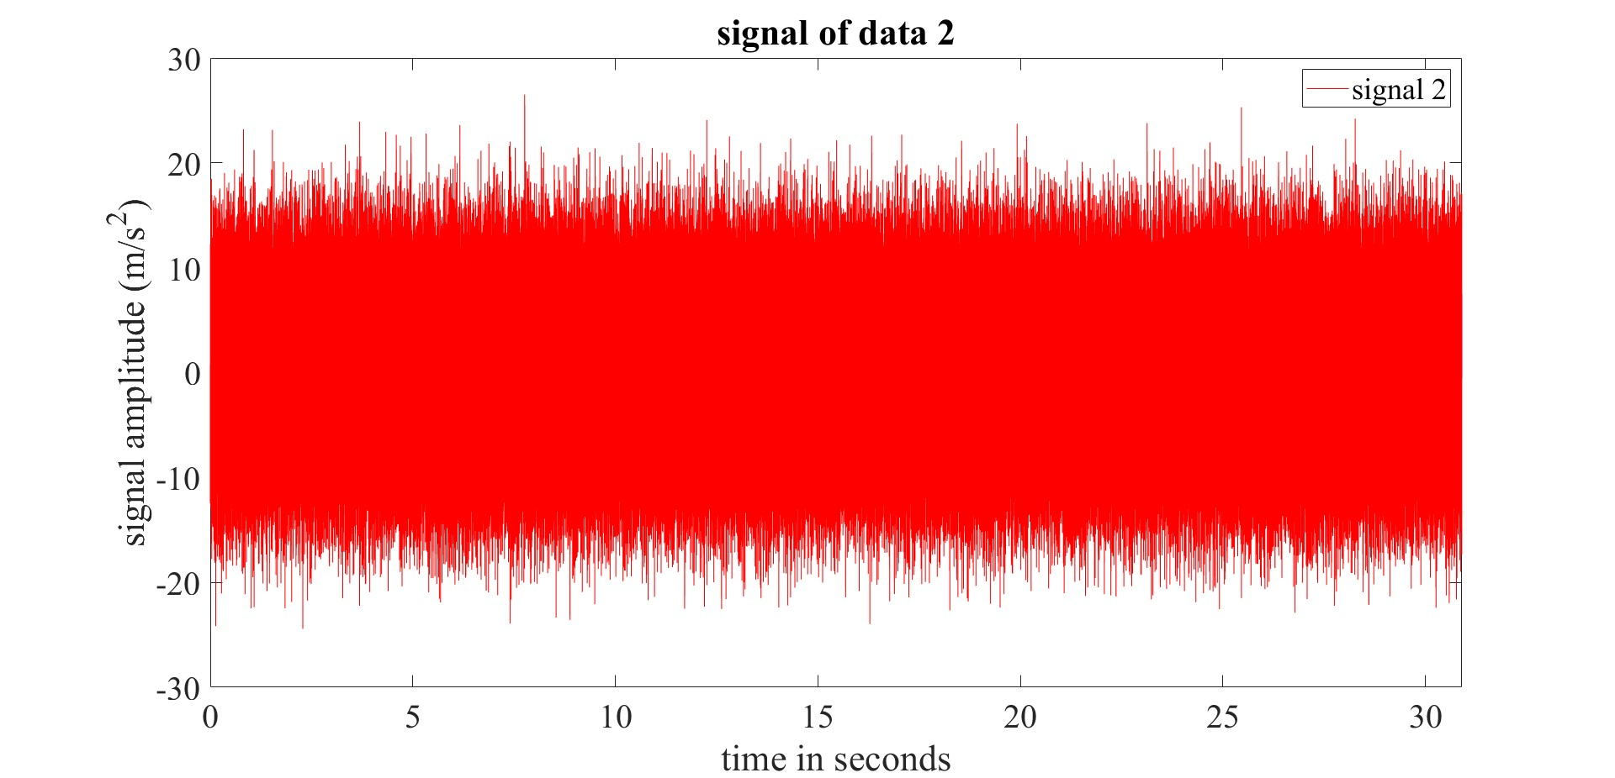
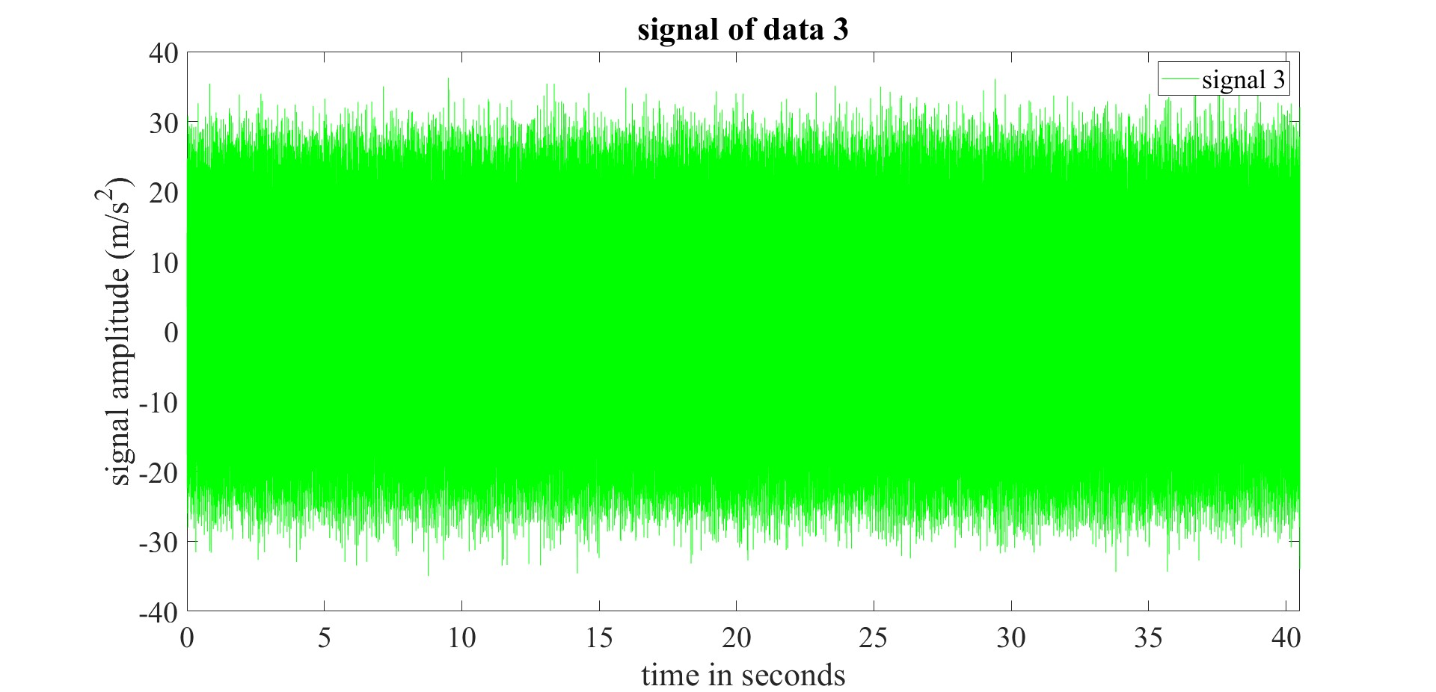
Time Domain Analysis

Slide 5
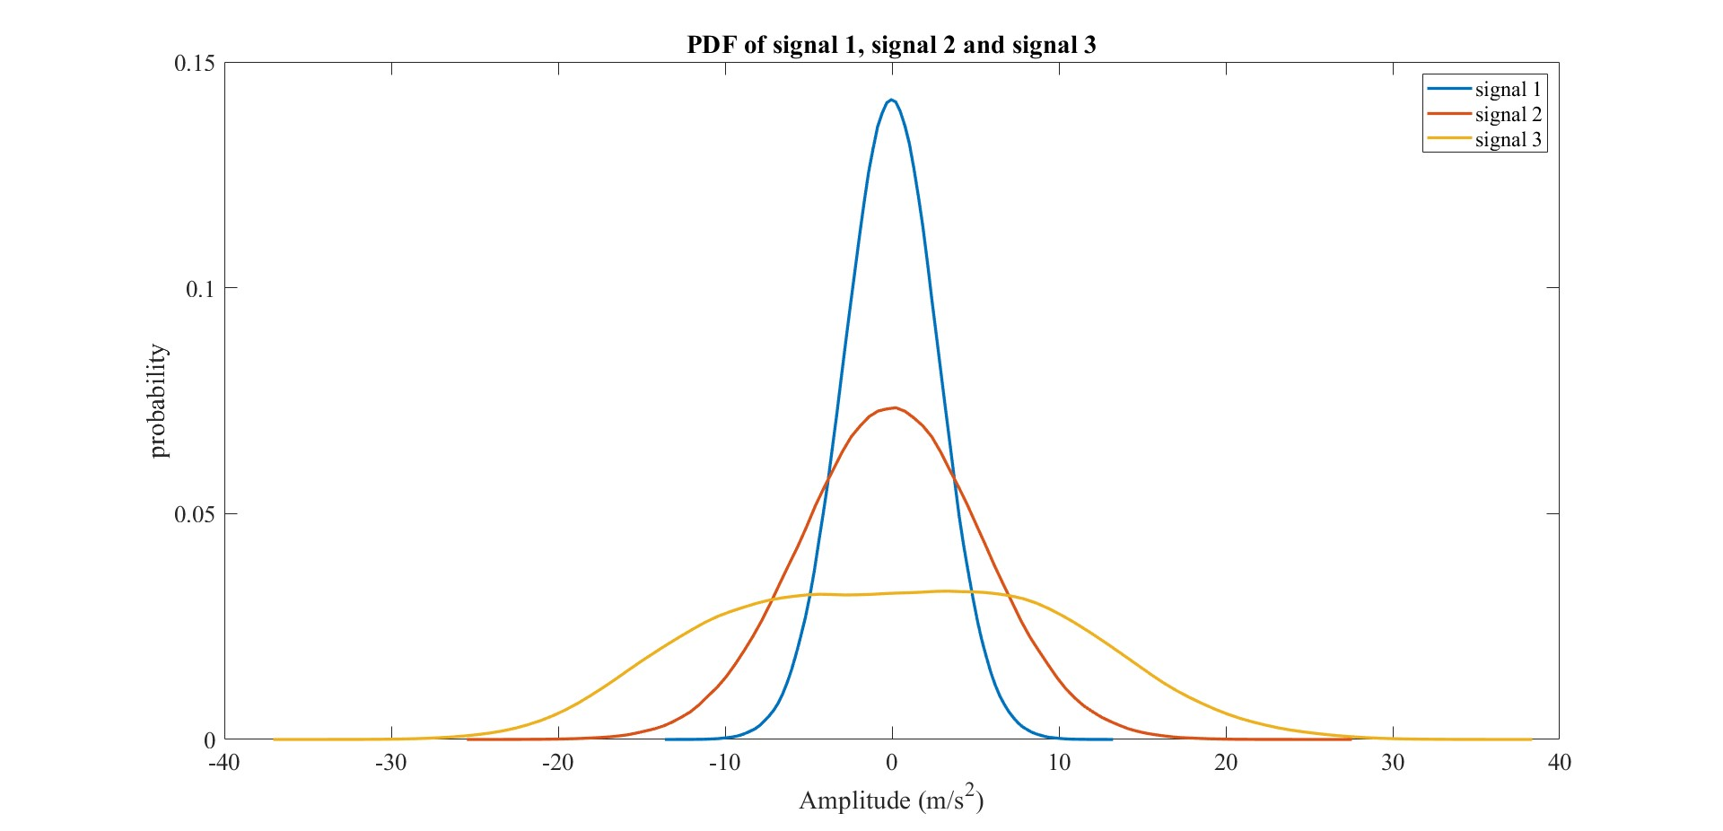
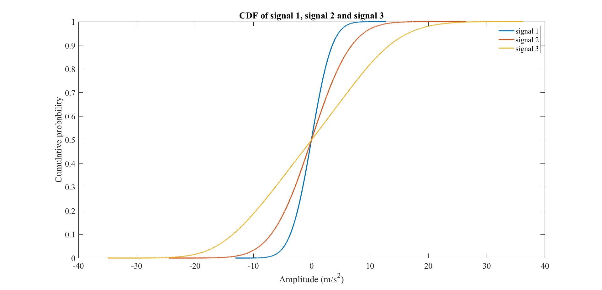
Time Domain Analysis
Probability Density Function (PDF) and Cumulative Distribution Function (CDF)
Observations:
No detection of Statistical based change
Features from time domain analysis are not informative

Slide 6
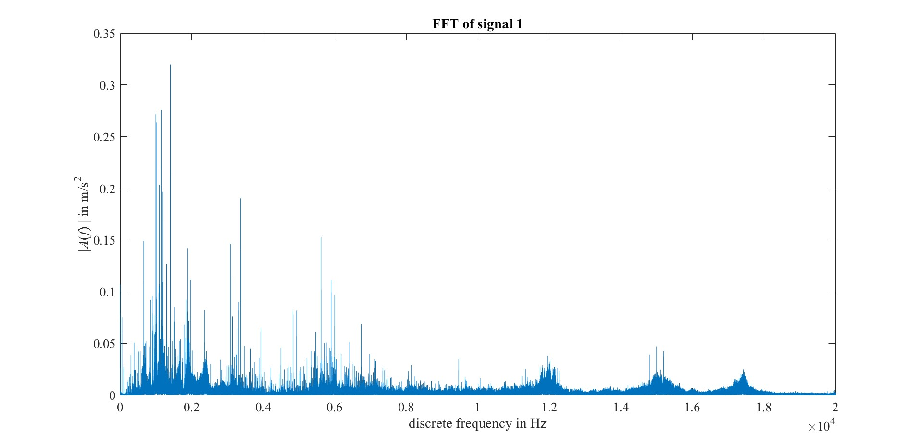
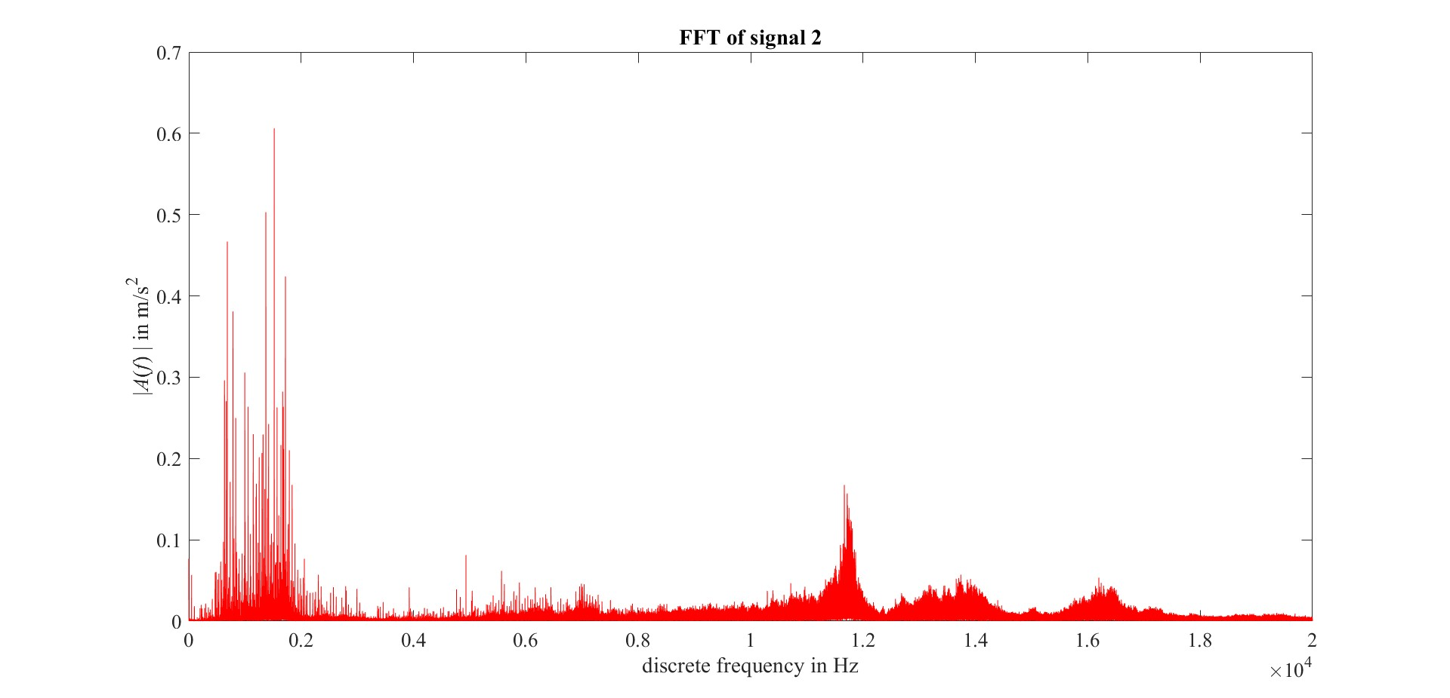
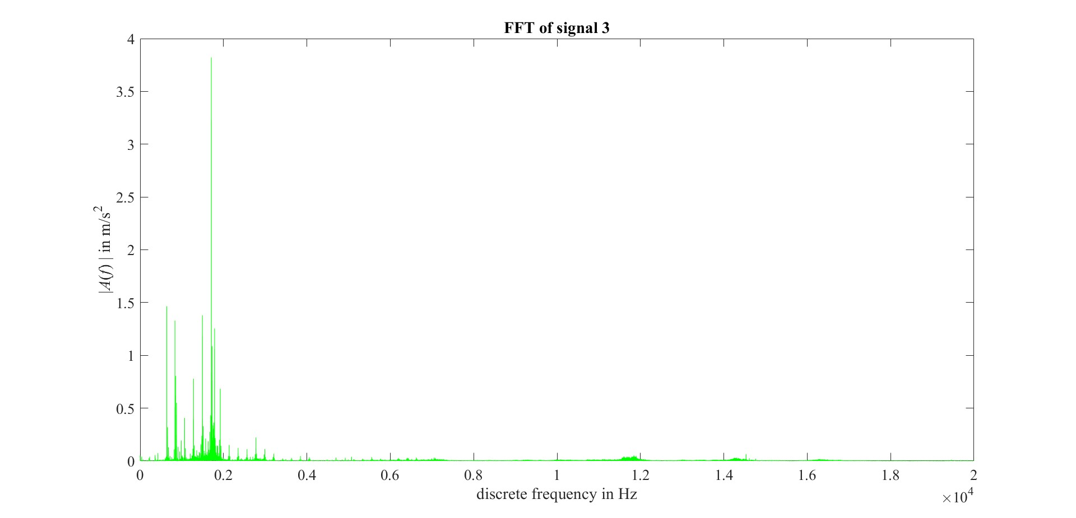
Frequency Domain Analysis
Fast Fourier Transform (FFT) of the measured signal data
Resonance because of shock shaped impulse
Damage frequency modulation with high frequency

Slide 7
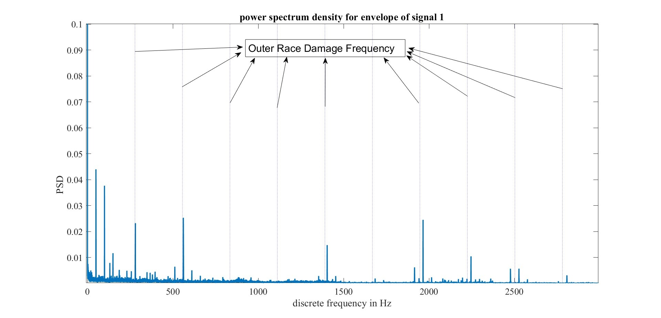
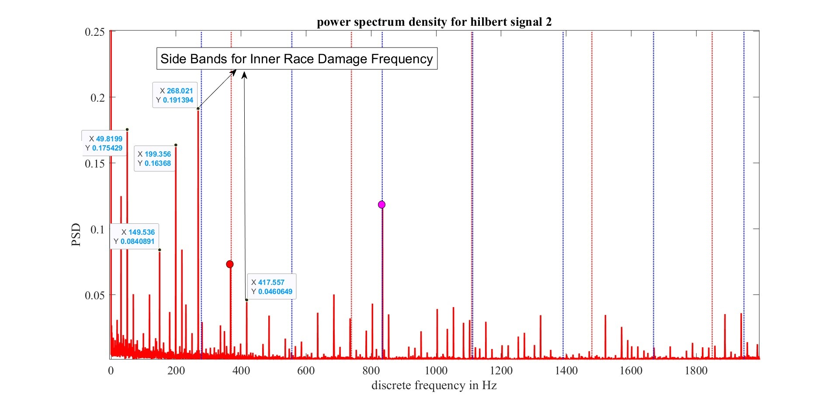
Frequency Domain Analysis
Envelope Formation for demodulation of damaged signal from high frequency
Power Spectrum Density of Envelope signal
Peak Energy in dB/Hz for Bearing 1
Outer Race Frequency and its harmonics
278.2 Hz (1x, 2x, 3x,..)
Bearing Roll Over Frequency and its harmonics
49.84 Hz (1x, 2x, 3x,..)
Peak Energy in dB/Hz for Bearing 2
Inner Race Frequency and its harmonics
369.81 Hz (1x, 2x, 3x,..)
Side Bands of ±49.84 Hz (1x, 2x,..) w.r.t. Inner race damage frequency because of modulation.

Slide 8
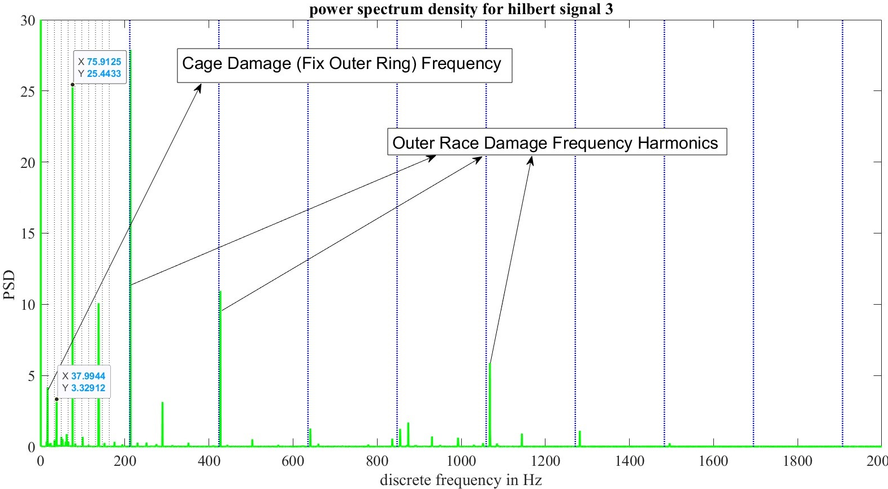
Frequency Domain Analysis
Note:
Envelope Spectrum of each bearing shows peak at Roll Over Frequency and its harmonics which indicates vibration signal measurement due to shaft’s rotation speed.
Peak Energy in dB/Hz for Bearing 3
Outer Race Frequency and its harmonics
211.856 Hz (1x, 2x, 3x,..)
Cage damage Frequency for Fix Outer Ring and its harmonics
16.30 Hz (1x, 2x, 3x,..)

Slide 9
Time-Frequency Domain Analysis
Signal Filtering by means of Spectral Kurtosis / Kurtograms
MATLAB: [kgram, f, w, fc, wc, bw] = kurtogram(x, fs)
Kurtogram
Frequency Vector
Window Size
Center Frequency at Kmax
Window size at Kmax
BandWidth for Optimal filter
Signal
Sampling Rate
Band-Pass Filter Design
MATLAB:
bpf = designfilter(‘bandpassfir’, ‘FilterOrder’, 100, ‘CutoffFrequency’, fc-bw/2, ‘CutoffFrequency’, fc+bw/2, ‘SampleRate’, fs)
FilteredSignal = filter(bpf, signal_data)

Slide 10
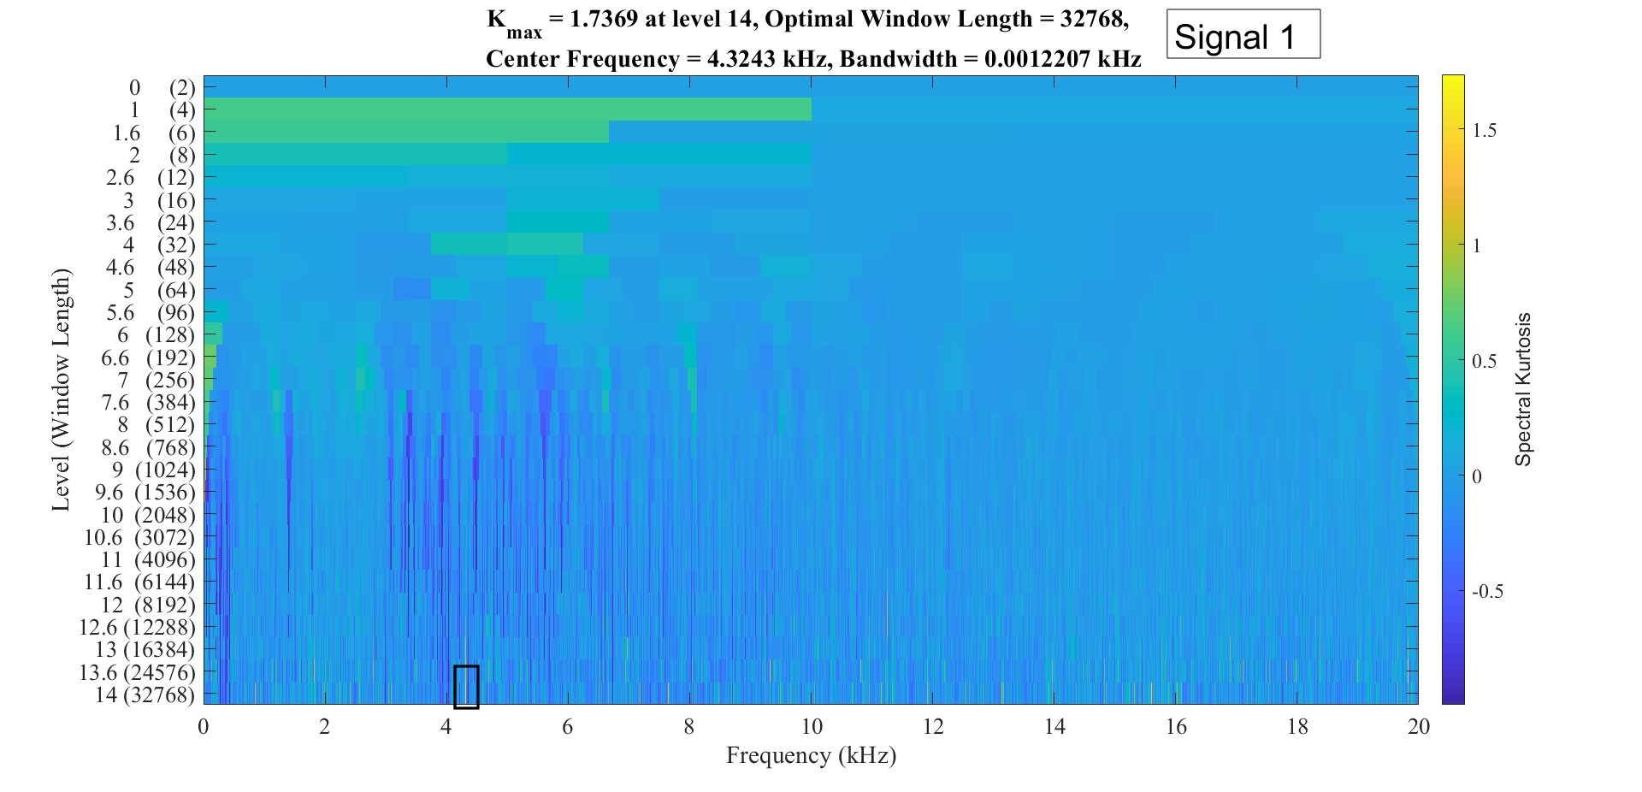
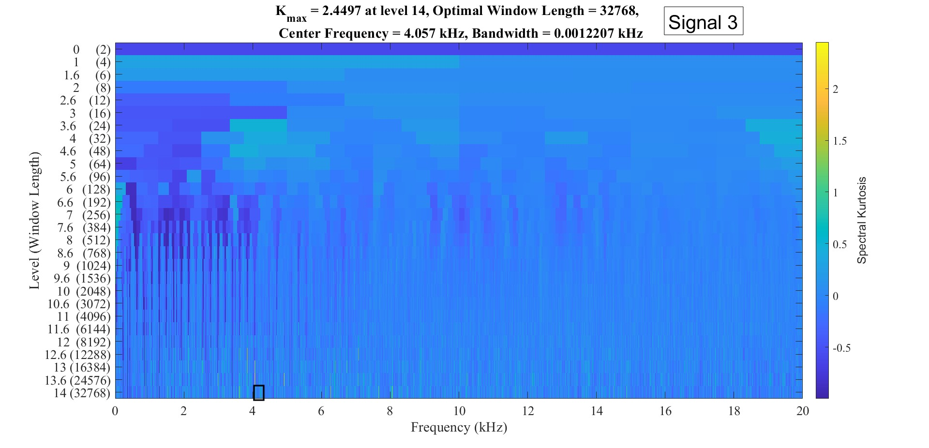
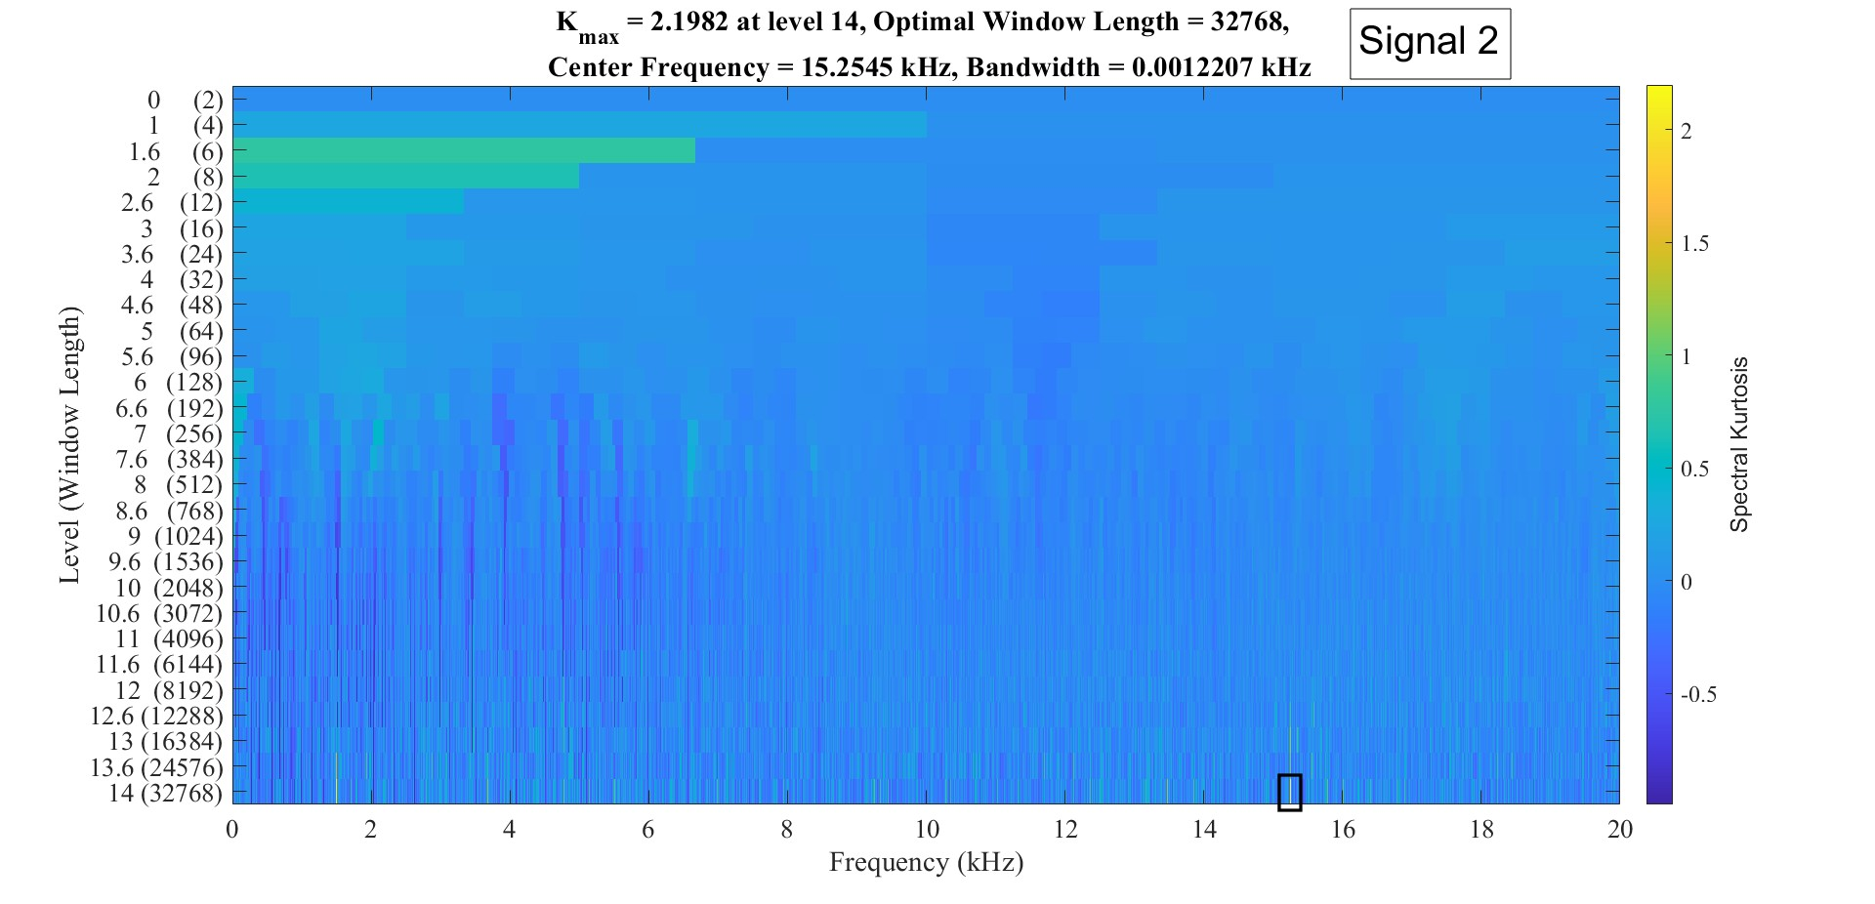
Kurtogram

Slide 11
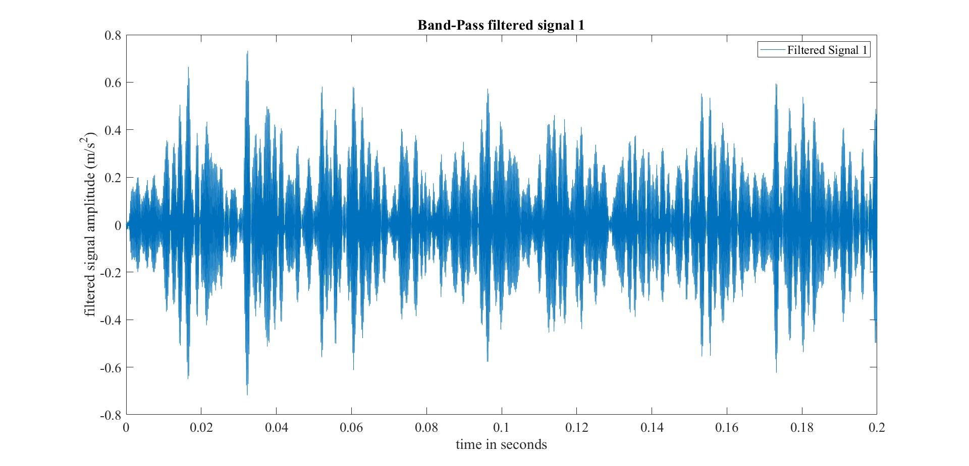
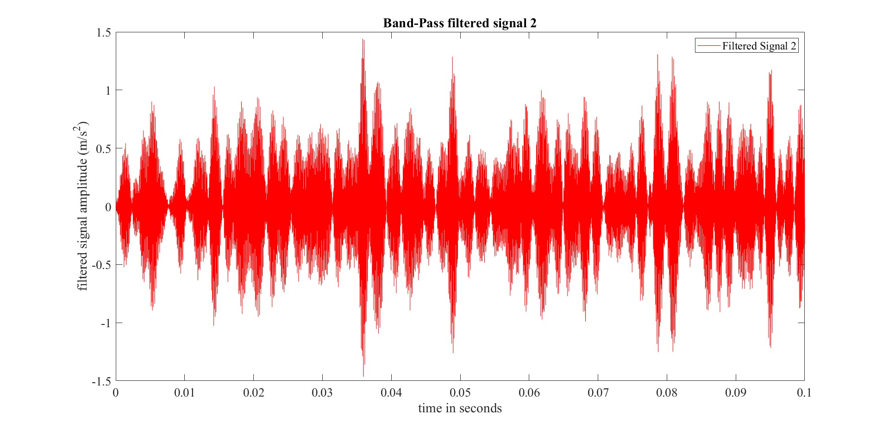
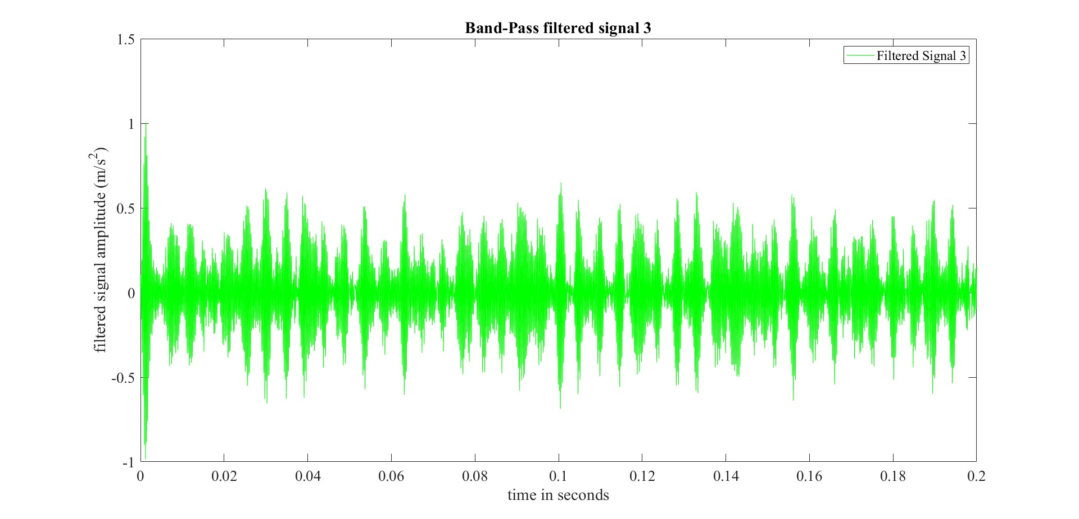
Bandpass Filtered Signal in time domain (Zoom)
Observation:
High frequency carrier signal
Low frequency modulated signal
High frequency – structural resonance
Low frequency – damaged frequency

Slide 12
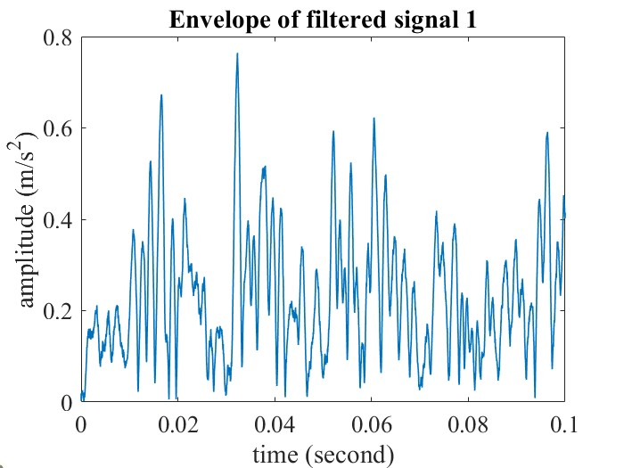
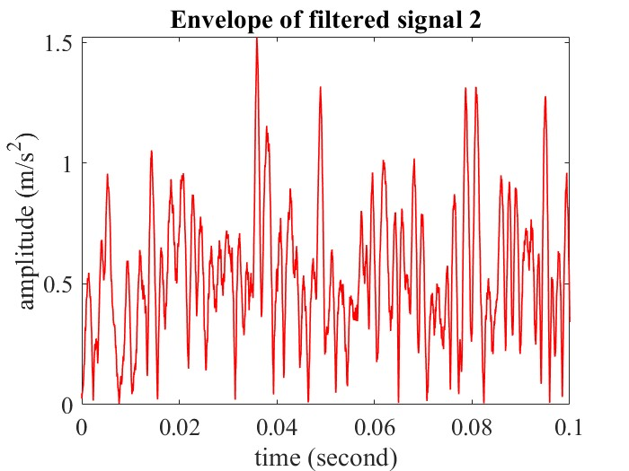
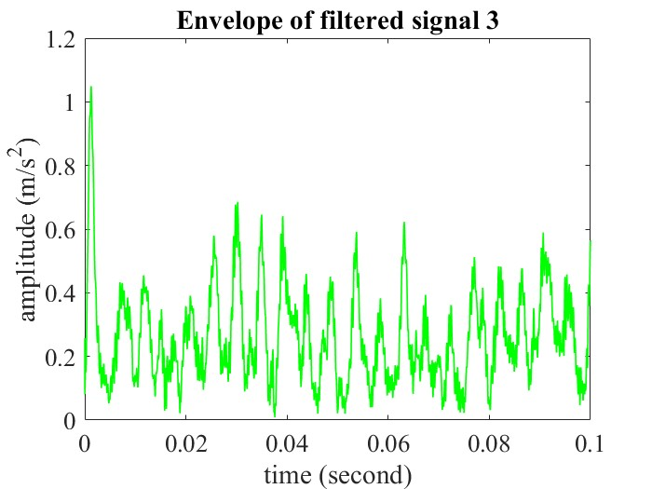
Envelope of Filtered Signal in Time Domain (Zoom)
Note:
Envelope of filtered signal calculated from given function hcurve_fun
Intuition
demodulation
Matlab:
E = hcurve(filt_signal, 1, N)
Plot(time, E)

Slide 13
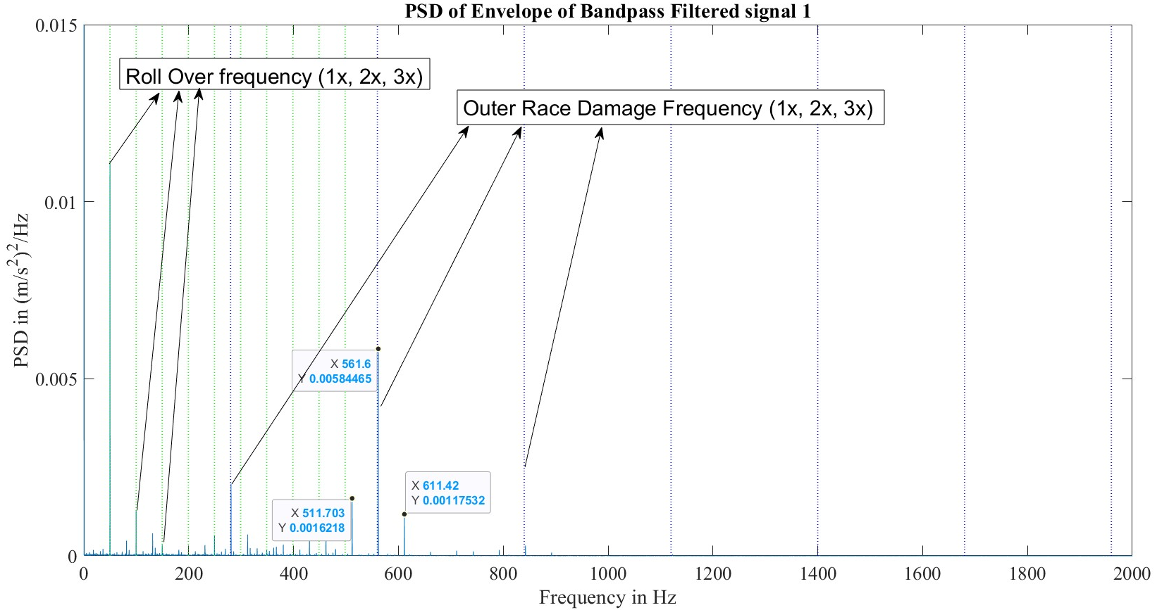
Envelope Spectra of Filtered Signal 1

Slide 14
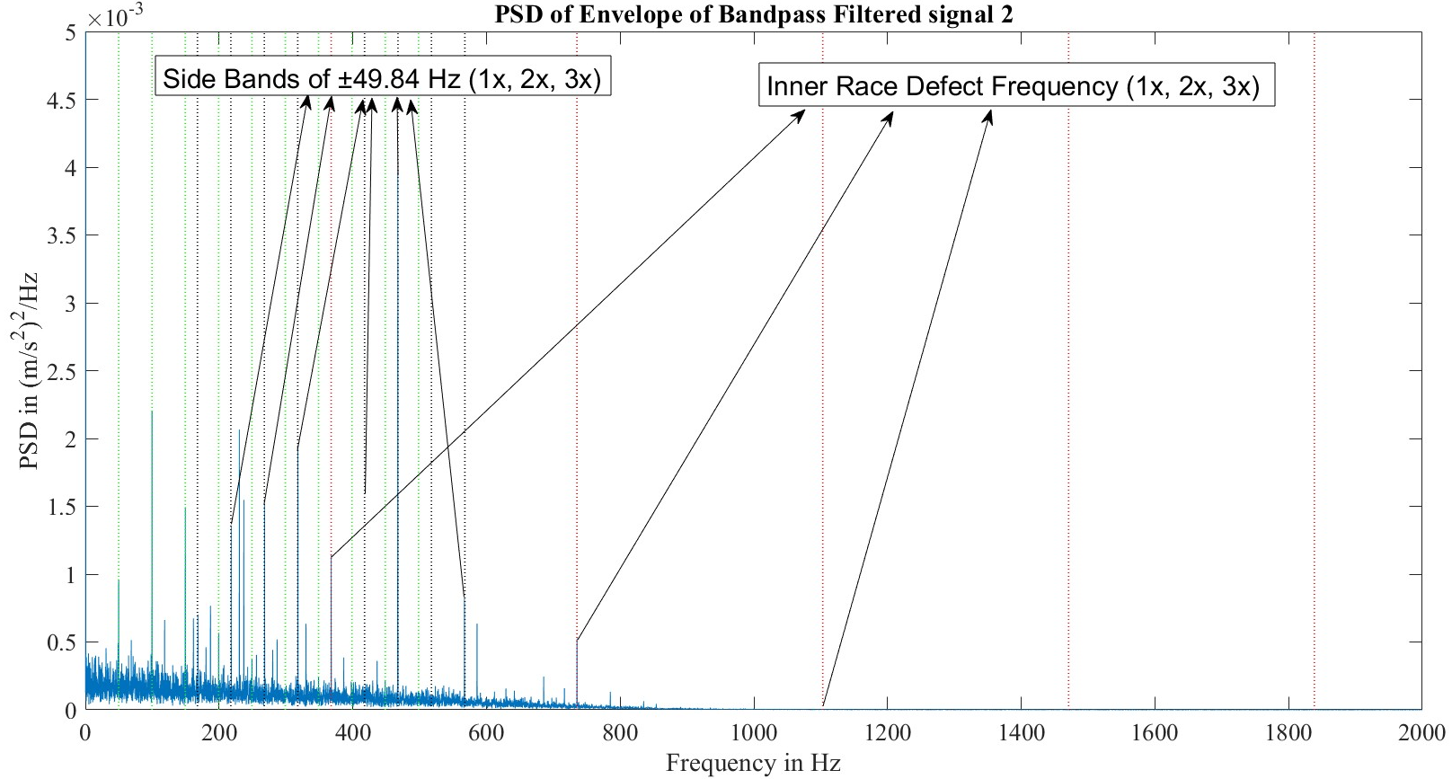
Envelope Spectra of Filtered Signal 2

Slide 15
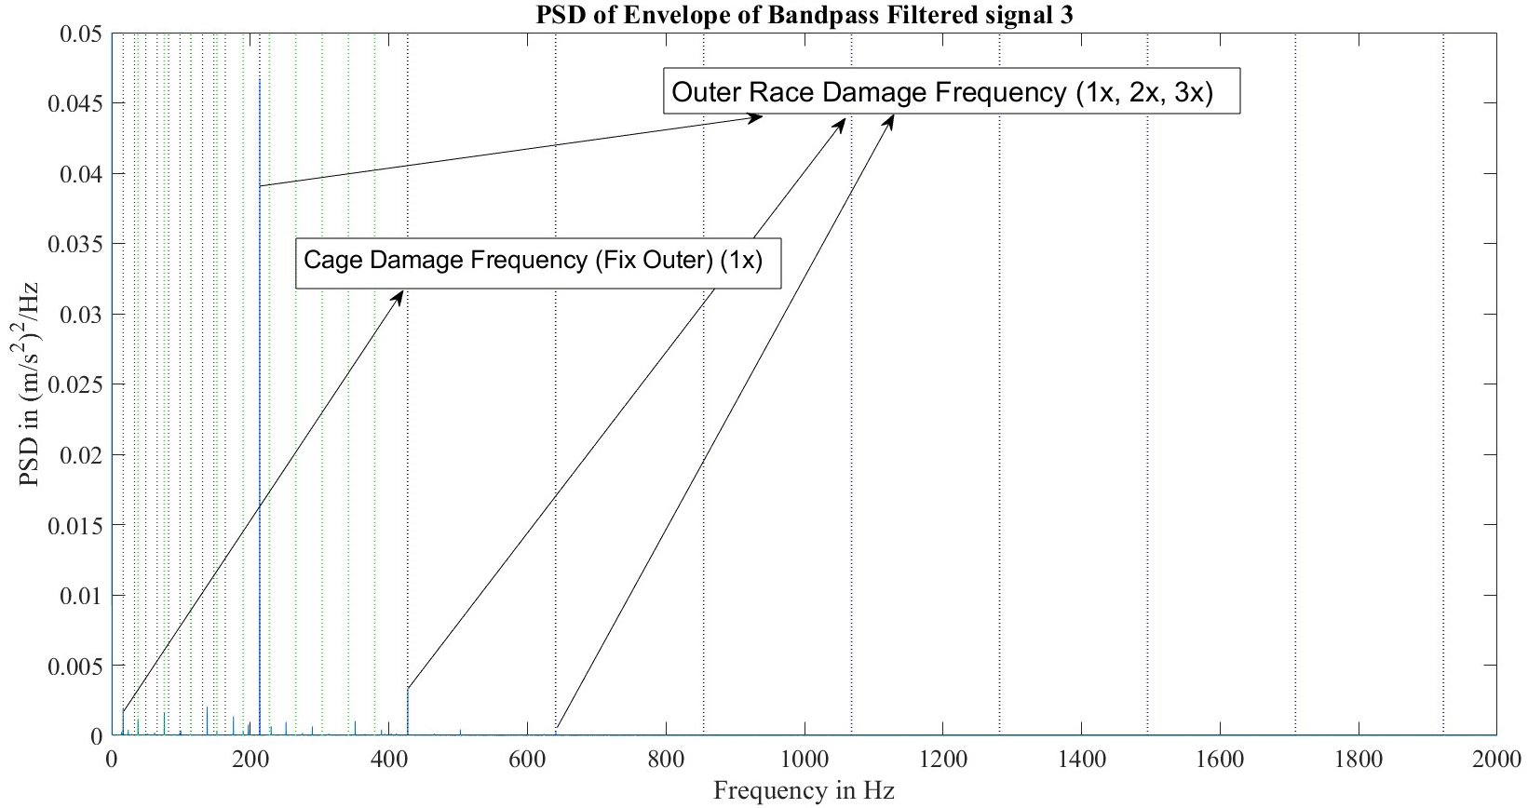
Envelope Spectra of Filtered Signal 3

Slide 16
Concluded Result
Bearing No. | File No. (WS2023_16) | Detected Damage
1 | file_004_23192223 | Damage on Outer Ring
2 | file_009_23192223 | Damage on Inner Ring
3 | file_023_23192223 | Damage on Outer Ring Damage on Cage with Fixed Outer Ring

Slide 17
Thank You!

